Slide 1
SQL - Crash Content
Syed Afroz Pasha
atomcamp

Slide 2
Agenda
Introduction
Core data concepts
Common use cases
Optimization 101
Interview Problem - Thought Process
Sample DRD - Process
atomcamp
Notes:
Our key themes are:
Environment: Our journey to net zero
Social: Our commitment to communities
Governance: Making great decisions
Corporate Affairs: Protecting our reputation and brand; by being proactive,
forward thinking and having the tools available to respond to crisis and defend our
reputation

Slide 3
Introduction
Education
Current role or industry
Upcoming plans in data
SQL (Good/Bad/Worst)
atomcamp
Notes:
Our key themes are:
Environment: Our journey to net zero
Social: Our commitment to communities
Governance: Making great decisions
Corporate Affairs: Protecting our reputation and brand; by being proactive,
forward thinking and having the tools available to respond to crisis and defend our
reputation

Slide 4
Concepts - Data
DB vs DWH
Dimensions, Facts
Normalized, Grain, Rollup, Drill down, Cube
SCDs
Load Types (Incremental/Full)
atomcamp
Notes:
Our key themes are:
Environment: Our journey to net zero
Social: Our commitment to communities
Governance: Making great decisions
Corporate Affairs: Protecting our reputation and brand; by being proactive,
forward thinking and having the tools available to respond to crisis and defend our
reputation

Slide 5
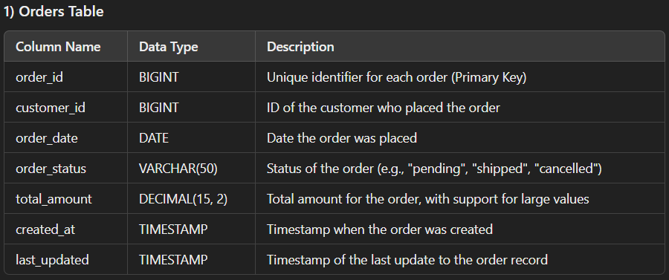
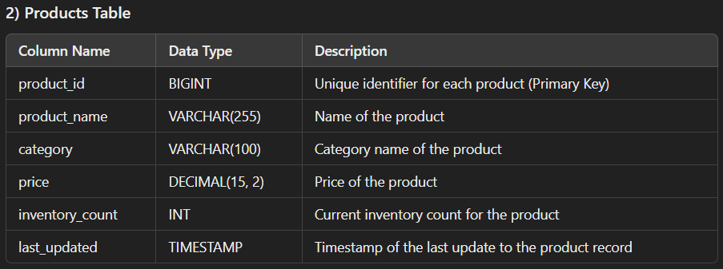
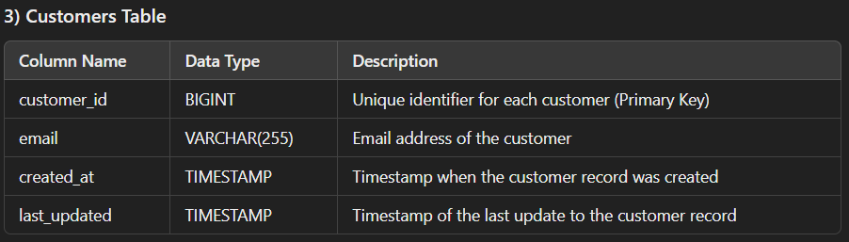
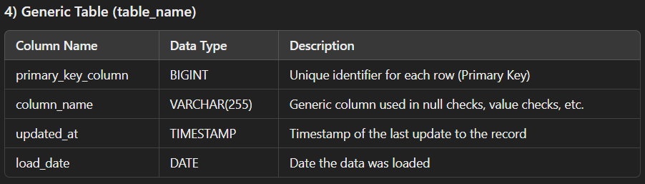
Data Driven - Common Tasks
atomcamp
Notes:
Our key themes are:
Environment: Our journey to net zero
Social: Our commitment to communities
Governance: Making great decisions
Corporate Affairs: Protecting our reputation and brand; by being proactive,
forward thinking and having the tools available to respond to crisis and defend our
reputation

Slide 6
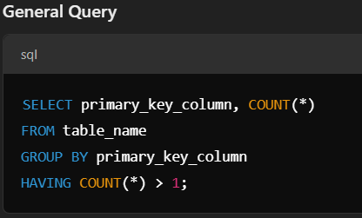
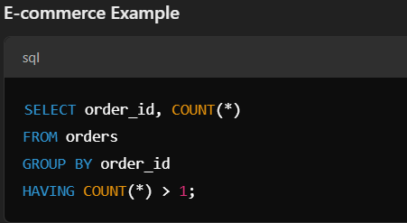
Data Driven - Common Tasks
1. Check the Primary Key/Grain Size
Purpose: Ensure data has a unique identifier for efficient analysis
atomcamp
Notes:
Our key themes are:
Environment: Our journey to net zero
Social: Our commitment to communities
Governance: Making great decisions
Corporate Affairs: Protecting our reputation and brand; by being proactive,
forward thinking and having the tools available to respond to crisis and defend our
reputation

Slide 7
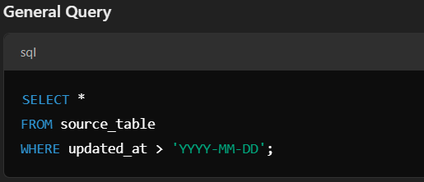
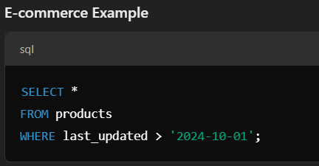
Data Driven - Common Tasks
2. Check if Data is Changed in Source
Purpose: Identify if the data in the source has been updated compared to the previous load
atomcamp
Notes:
Our key themes are:
Environment: Our journey to net zero
Social: Our commitment to communities
Governance: Making great decisions
Corporate Affairs: Protecting our reputation and brand; by being proactive,
forward thinking and having the tools available to respond to crisis and defend our
reputation

Slide 8
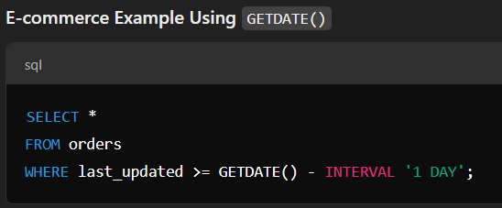
Data Driven - Common Tasks
2. Check if Data is Changed in Source
Purpose: Identify if the data in the source has been updated compared to the previous load
atomcamp
Notes:
Our key themes are:
Environment: Our journey to net zero
Social: Our commitment to communities
Governance: Making great decisions
Corporate Affairs: Protecting our reputation and brand; by being proactive,
forward thinking and having the tools available to respond to crisis and defend our
reputation

Slide 9
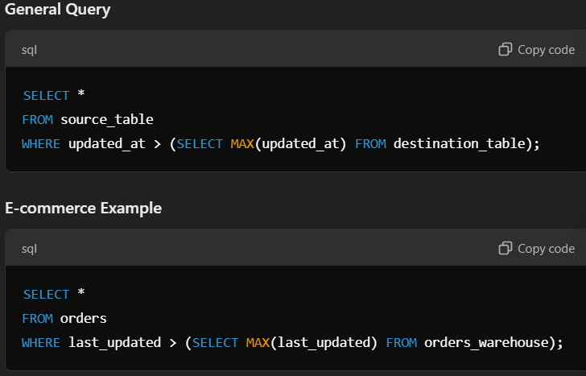
Data Driven - Common Tasks
3. Get the Delta When Source Tables Are Updated
Purpose: Extract only the updated or new data for processing
atomcamp
Notes:
Our key themes are:
Environment: Our journey to net zero
Social: Our commitment to communities
Governance: Making great decisions
Corporate Affairs: Protecting our reputation and brand; by being proactive,
forward thinking and having the tools available to respond to crisis and defend our
reputation

Slide 10
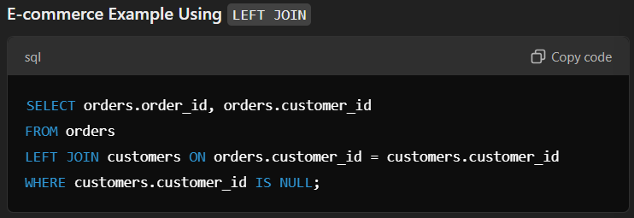
Data Driven - Common Tasks
3. Get the Delta When Source Tables Are Updated
Purpose: Extract only the updated or new data for processing
atomcamp
Notes:
Our key themes are:
Environment: Our journey to net zero
Social: Our commitment to communities
Governance: Making great decisions
Corporate Affairs: Protecting our reputation and brand; by being proactive,
forward thinking and having the tools available to respond to crisis and defend our
reputation

Slide 11
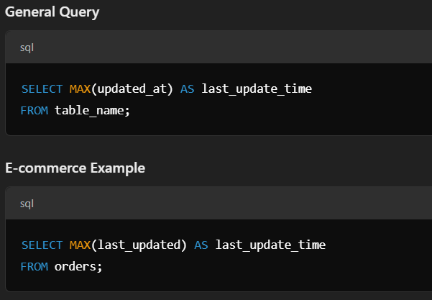
Data Driven - Common Tasks
4. Freshness Check
Purpose: Ensure that the data is up-to-date and not stale
atomcamp
Notes:
Our key themes are:
Environment: Our journey to net zero
Social: Our commitment to communities
Governance: Making great decisions
Corporate Affairs: Protecting our reputation and brand; by being proactive,
forward thinking and having the tools available to respond to crisis and defend our
reputation

Slide 12
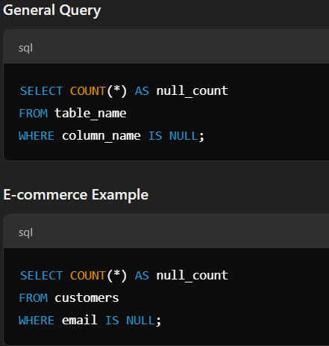
Data Driven - Common Tasks
5. Null Values Check
Purpose: Identify records where important columns have missing values
atomcamp
Notes:
Our key themes are:
Environment: Our journey to net zero
Social: Our commitment to communities
Governance: Making great decisions
Corporate Affairs: Protecting our reputation and brand; by being proactive,
forward thinking and having the tools available to respond to crisis and defend our
reputation

Slide 13
Data Driven - Common Tasks
6. Duplicate Records Check
Purpose: Identify records where important columns have missing values
atomcamp
Notes:
Our key themes are:
Environment: Our journey to net zero
Social: Our commitment to communities
Governance: Making great decisions
Corporate Affairs: Protecting our reputation and brand; by being proactive,
forward thinking and having the tools available to respond to crisis and defend our
reputation

Slide 14
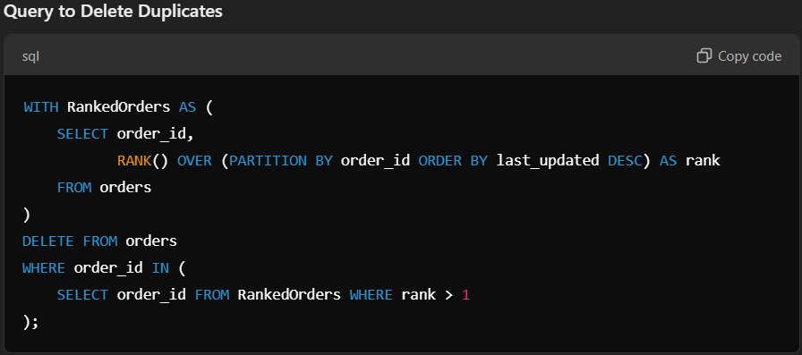
Data Driven - Common Tasks
7. Remove Duplicate Records
Purpose: Keep only the latest record for each order_id and delete the older duplicates
atomcamp
Notes:
Our key themes are:
Environment: Our journey to net zero
Social: Our commitment to communities
Governance: Making great decisions
Corporate Affairs: Protecting our reputation and brand; by being proactive,
forward thinking and having the tools available to respond to crisis and defend our
reputation

Slide 15
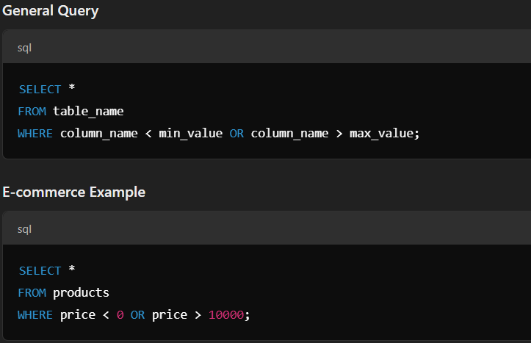
Data Driven - Common Tasks
8. Data Range Check
Purpose: Ensure numeric values fall within an acceptable range or logical limits
atomcamp
Notes:
Our key themes are:
Environment: Our journey to net zero
Social: Our commitment to communities
Governance: Making great decisions
Corporate Affairs: Protecting our reputation and brand; by being proactive,
forward thinking and having the tools available to respond to crisis and defend our
reputation

Slide 16
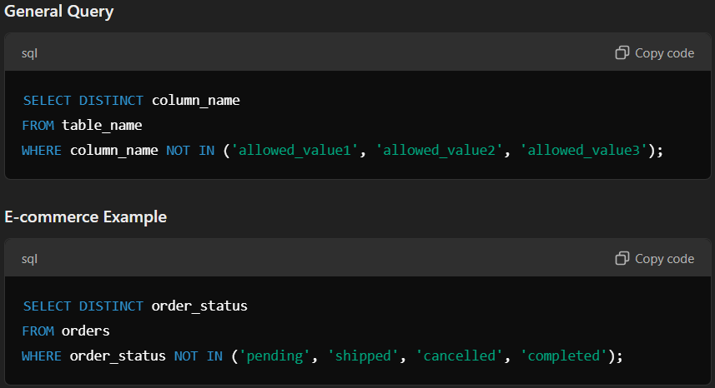
Data Driven - Common Tasks
9. Value Consistency Check
Purpose: Verify that specific columns have only allowed or consistent values
atomcamp
Notes:
Our key themes are:
Environment: Our journey to net zero
Social: Our commitment to communities
Governance: Making great decisions
Corporate Affairs: Protecting our reputation and brand; by being proactive,
forward thinking and having the tools available to respond to crisis and defend our
reputation

Slide 17
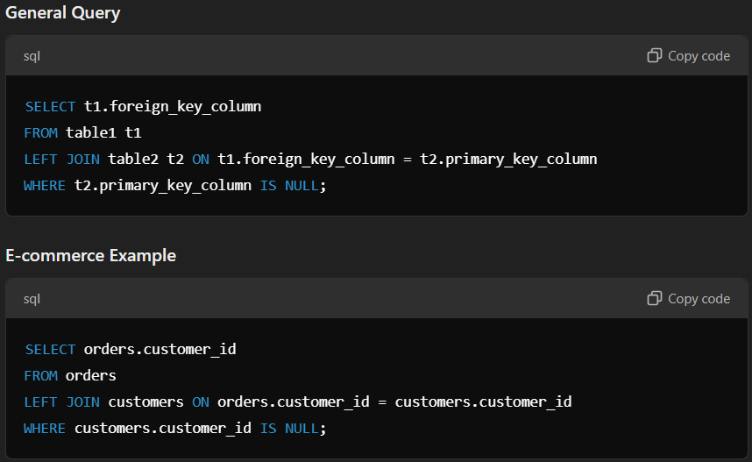
Data Driven - Common Tasks
10. Referential Integrity Check
Purpose: Validate that foreign key relationships between tables are intact
atomcamp
Notes:
Our key themes are:
Environment: Our journey to net zero
Social: Our commitment to communities
Governance: Making great decisions
Corporate Affairs: Protecting our reputation and brand; by being proactive,
forward thinking and having the tools available to respond to crisis and defend our
reputation

Slide 18
Optimization 101
Select *
On/Where clauses
Partitions/Index
Joins
Data Skewness
Wildcards
Having/Where
atomcamp
Notes:
Energy/Carbon Use
Water Use
Waste
Responsible Procurement
Business Travel

Slide 19
Common Issues
1. Select * from table
atomcamp
Notes:
Energy/Carbon Use
Water Use
Waste
Responsible Procurement
Business Travel

Slide 20
Solution:
Use Column Names
e.g. Select a, b, c from table
atomcamp

Slide 21
Common Issues
2. Frequent usage of same Table
Solution:
Use CTEs e.g. WITH cte1_name as (statement 1), cte2_name as (statement 2) SELECT a, b, c from cte1_name
atomcamp
Notes:
Energy/Carbon Use
Water Use
Waste
Responsible Procurement
Business Travel

Slide 22
Common Issues
3. Using Inefficient Pattern Matching WHERE emp_name LIKE ‘%a%’
Solution:
Use CTEs e.g. WITH cte1_name as (statement 1), cte2_name as (statement 2) SELECT a, b, c from cte1_name
atomcamp
Notes:
Energy/Carbon Use
Water Use
Waste
Responsible Procurement
Business Travel

Slide 23
Common Issues
4. Calculations in JOIN and WHERE clause select a.coll, b.col2
from table1 as a join table2 as b
on (a.coll +50 = b.col2);
atomcamp
Notes:
Energy/Carbon Use
Water Use
Waste
Responsible Procurement
Business Travel

Slide 24
Solution:
Use CTEs e.g. with CTE as
(select a.col1 + 50 as C1 FROM table1 )
select CTE.C1, b.col2 from CTE join table2 b on (CTE.C1 = b.col2);
atomcamp

Slide 25
Common Issues
5. Functions in Predicates select t1.col1, t2.col2 from table1 as t1
join table2 as t2
on upper(t1.col1) = t2.col2;
atomcamp
Notes:
Energy/Carbon Use
Water Use
Waste
Responsible Procurement
Business Travel

Slide 26
Solution:
Use CTEs e.g. with CTE1 as (select upper(col1) as C1, col1 FROM table1)
select t1.col1, t2.col2 from CTE1 as t1
join table2 as t2
on t1.C1 = t2.col2;
atomcamp

Slide 27
Common Issues
6. Limit or Filter the data late a join b where a.col !=null
atomcamp
Notes:
Energy/Carbon Use
Water Use
Waste
Responsible Procurement
Business Travel

Slide 28
Solution:
Use subquery or CTE e.g. (select * from a where a.col!=null) join b
atomcamp

Slide 29
Common Issues
7. Use WHERE instead of HAVING to define Filters on non-aggregate Columns
atomcamp
Notes:
Energy/Carbon Use
Water Use
Waste
Responsible Procurement
Business Travel

Slide 30
Common Issues
SELECT C.CustomerID, C.Name, Count(S.SalesID)
FROM Customers as C
INNER JOIN Sales as S
ON C.CustomerID = S.CustomerID
GROUP BY C.CustomerID, C.Name
HAVING S.LastSaleDate BETWEEN ‘1/1/2019’ AND ‘12/31/2019’;
atomcamp
Notes:
Energy/Carbon Use
Water Use
Waste
Responsible Procurement
Business Travel

Slide 31
Solution:
SELECT C.CustomerID, C.Name, Count(S.SalesID)
FROM Customers as C
INNER JOIN Sales as S
ON C.CustomerID = S.CustomerID
WHERE S.LastSaleDate BETWEEN ‘1/1/2019’ AND ‘12/31/2019’
GROUP BY C.CustomerID, C.Name;
atomcamp

Slide 32
Common Issues
8. Avoid exclusivity select count(distinct(col)) from table
Select count(*) from (select distinct(col) from table)
atomcamp
Notes:
Energy/Carbon Use
Water Use
Waste
Responsible Procurement
Business Travel

Slide 33
Common Issues
9. Joining Tables with different Granularity
Solution:
Rollup or Drill down
atomcamp
Notes:
Energy/Carbon Use
Water Use
Waste
Responsible Procurement
Business Travel

Slide 34
Common Issues
10. Data Skew/Skew Joins
Solution:
Rollup or Drill down
atomcamp
Notes:
Energy/Carbon Use
Water Use
Waste
Responsible Procurement
Business Travel

Slide 35
Common Issues
WITH dim_pub_numbers as ( select 0 union all select 1 union all select 2 union all select 3 union all select 4 union all select 5 union all select 6 union all select 7 union all select 8 union all select 9);
SELECT seller_id,
atomcamp
Notes:
Energy/Carbon Use
Water Use
Waste
Responsible Procurement
Business Travel

Slide 36
Common Issues
11. Join Before Aggregation
Solution:
Rollup or Drill down
atomcamp
Notes:
Energy/Carbon Use
Water Use
Waste
Responsible Procurement
Business Travel

Slide 37
Interview Problem - Thought Process
I have a transactions table for a single year with the amount indicating the debit transaction if the value is negative or credit transaction values are positive.
Now in a given month if the number of debit records is less than 3 or if the sum of debits for a month is less than 100 then I want to charge a fee of 5.
atomcamp
Notes:
Our key themes are:
Environment: Our journey to net zero
Social: Our commitment to communities
Governance: Making great decisions
Corporate Affairs: Protecting our reputation and brand; by being proactive,
forward thinking and having the tools available to respond to crisis and defend our
reputation

Slide 38
Data Driven - DRD
atomcamp
Notes:
Our key themes are:
Environment: Our journey to net zero
Social: Our commitment to communities
Governance: Making great decisions
Corporate Affairs: Protecting our reputation and brand; by being proactive,
forward thinking and having the tools available to respond to crisis and defend our
reputation

Slide 39
Thank You! Questions
atomcamp
Notes:
Energy/Carbon Use
Water Use
Waste
Responsible Procurement
Business Travel

